Slide 1
PREDICTION OF COMPRESSIVE STRENGTH OF CONCRETE
Presented By:-
Siona Panda
RSIP Career Basic-ML(Slot-17)

Slide 2
INTRODUCTION
OVERVIEW
Concrete has a versatile use in the construction practice for its availability, cheap rate, flexibility of handling and giving shape to any desired form. Designing a concrete structure requires the concrete compressive strength to be used. The design strength of the concrete normally represents its 28th day strength. In case of construction work 28 days is considerable time to wait for the test results of Concrete strength, while it also represents the quality control process of concrete mixing, placing, proper curing etc. Concrete mix design is a process done by using code recommendation and sometimes by experience. If due to some experimental error in mix design the test results fail to achieve the designed strength, then repetition of the entire process becomes mandatory, which can be costly and time-consuming. For every failure, it is necessary to wait for at least 28 days, thus the need for an easy and suitable method for estimating the strength at an early age of concrete is being felt all the time. Hence, a rapid and reliable Concrete strength prediction would be of great significance.

Slide 3
INTRODUCTION
PURPOSE
In the construction process, it is always important to know the concrete compressive strength. The recommended procedure to ensure the concrete strength is to perform cylinder test. The test result of concrete cylinder at 28th day, represents the characteristic strength of the concrete that has been prepared and cast to form the concrete work. Usually two concrete cylinders (specimen) are cast for each day’s representative strength test. The 3-days or 7-days tests are done to assess the early gain of concrete strength. However, 28-days tests are mandatory as per design/construction code requirements. Waiting 28 days is quite time consuming while it is important to ensure the quality control process. This project is an attempt to develop a simple mathematical model based on concrete’s nature of strength gain to predict the compressive strength of concrete at 28th day from early age results. The model is Random Forest Regressor.The proposed model has a good potential to predict concrete strength at different age with high accuracy.

Slide 4
LITERATURE SURVEY
EXISTING PROBLEM
Concrete has versatile use in the construction practice.
The compressive strength is one of the most important and useful properties of concrete.
The design strength of the concrete represents its 28th day strength.
28 days is a considerable time to wait for the test results of concrete strength, while it is mandatory to represent the process of quality control.
For every mix one has to wait a long time for the assurance of its quality.
Hence, the need for an easy and suitable means for estimating the strength at an early age of concrete is being felt all the time.

Slide 5
LITERATURE SURVEY
PROPOSED SOLUTION
To Evaluate concrete strength gain pattern with time for a particular type of mix.
To formulate a quick, handy and flexible computational method to assess the nature of concrete strength gain with time.
To develop a simple relation which has the potential to predict the compressive strength of concrete from early days strength.

Slide 6
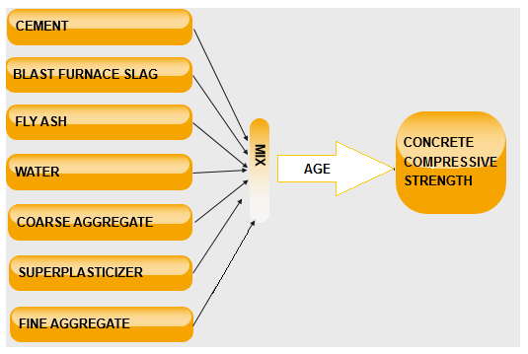
BLOCK DIAGRAM OF THE DATASET

Slide 7
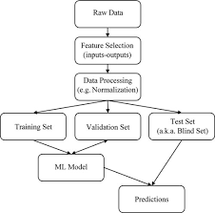
FLOW CHART FOR BUILDING A MACHINE LEARNING MODEL

Slide 8
ADVANTAGES OF PREDICTING COMPRESSIVE STRENGTH OF CONCRETE BY MACHINE LEARNING
Employing machine learning approaches instead of traditional models makes it possible to develop a better understanding of the compressive strength of concrete.
Machine learning approaches, can use the available databases in the literature, with no need for the evaluation by specific experimental tests.
These models consider other effective parameters in concrete behaviour, and their accuracies depend on the size and variety of the database. Afterwards, these models could be used as a proper tool for the validation and verification of the existing models used by the building codes.
The advantage of the random forest method is that it significantly reduces the instability of simple regression trees. Furthermore, this method has been shown to minimize correlation between trees compared to other tree-ensemble methods (e.g. “bagging trees” that use only bootstrap aggregation and not random variable selection).
The ability of machine learning models trained on laboratory concrete data to predict the compressive strength of field concrete mixtures is evaluated and compared to those models trained exclusively on field concrete data. The analysis shows that the hybridization of field and laboratory data for building predictive models is a promising method for reducing common over-prediction issues caused by laboratory concrete models that are used in isolation.
The main advantages of RFR are the assumption of functional form is not needed and that tolerance to imprecise data sets is better. The non-linear nature of RFR also makes it very suitable for many complicated problems involving modeling and prediction.

Slide 9
APPLICATIONS OF PREDICTING COMPRESSIVE STRENGTH OF CONCRETE BY MACHINE LEARNING
Random Forest Regression techniques are amongst the areas in machine learning that have grown fast and gained popular engineering applications and have been employed in many civil engineering applications such as detection of structural damage, structural system identification, material behaviour modelling, groundwater monitoring, foundation settlement prediction, concrete mix proportioning and concrete strength prediction.
In recent years, the ML methods have become popular as they allow researchers to improve the prediction accuracy of concrete properties and are used for various engineering applications.
As these RFR models exhibited acceptable prediction accuracy, their applications were extended to high strength concrete, self-consolidating concrete, recycled aggregate concrete.
These models were developed for applications in concrete structures.These tools were used to predict the compressive strength, split tensile strength and flexural strength of the concrete at 28 days, and sensitivity analysis of the RFR was used to find the mixing ratio of sintered fly ash aggregate concrete.

Slide 10
APPLICATIONS OF PREDICTING COMPRESSIVE STRENGTH OF CONCRETE BY MACHINE LEARNING
Other applications of RFRs include damage detection in beams by utilising vibration measurements and the assessment of shear resistance in concrete beams.
Further applications of RFR have been intended at determining with high accuracy not only the compressive strength but also the corresponding strain in circular concrete columns and in FRP-confined square/rectangular columns.
ML methods have been used to increase the prediction accuracy of concrete properties and for various other engineering applications.
Technological advancement allows engineering problems to be solved by the use of machine learning methods and their applications can represent good examples of fields explored with different expectations and realistic results.

Slide 11
CONCLUSION
This project aimed to present the study of computational intelligence applied to define the concrete compressive strength obtained from a open-source dataset. The computational method of machine learning and artificial intelligence was used, namely Random Forest Regressor. Data pre-processing and data visualization methods were also used to improve the results.
The obtained results show that the Random Forest gave the best performance (R2 Score=87.34% and MSE=32.49%) and an average execution time.The overall error rate can be considered low and the techniques can adequately be used to predict the concrete compressive strength, staying within the acceptable safety range for engineering practices.

Slide 12
FUTURE SCOPE
The computational intelligence models used are reliable to solve different complex problems, such as prediction problems. These models can be used to solve a specific problem when a deviation in available data is expected and accepted, and when a defined methodology is not available. Therefore, to predict the properties of concrete with high reliability, instead of using expensive experimental investigation, conventional and innovative models can be replaced by computational intelligence models.
Computational intelligence models can be used to predict the compressive strength of concrete specimens, as shown in this study. The prediction of mean percent error values for these simulations shows a high degree of consistency with compressive strength and is experimentally evaluated from the concrete specimens used. Thus, the present study suggests an alternative approach to evaluate compressive strength against destructive testing methods.Therefore future models should take into account the influence of mix constituents on the concrete strength to yield more reliable and accurate predictions.

Slide 13
THANK YOU

